Slide 1


Slide 2

Charette Procedure

Slide 3
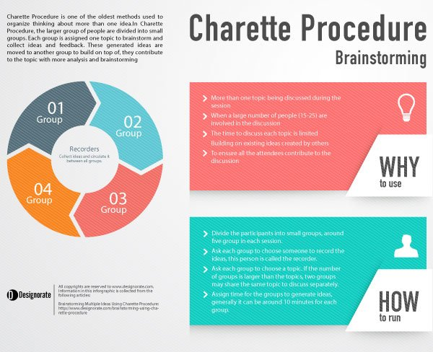
What is the Charette Procedure?
The Charette Procedure is one of the oldest methods used to organize thinking about one or more ideas and helps them all to form an opinion within a large group of people.
There are 15 people or more present in a brainstorming session when attempting to discuss multiple ideas or problems at the same time.
The ideas generated by one group are sent to the other group, allowing that group to think about them and refine the earlier ideas.
Notes:
It comes from the French word ‘charrette’, meaning ‘cart’.
In the 19th century, architecture students would use little carts to quickly get their drawings from one place to another, to get approval for their work. The Charette Procedure works the same way.

Slide 4
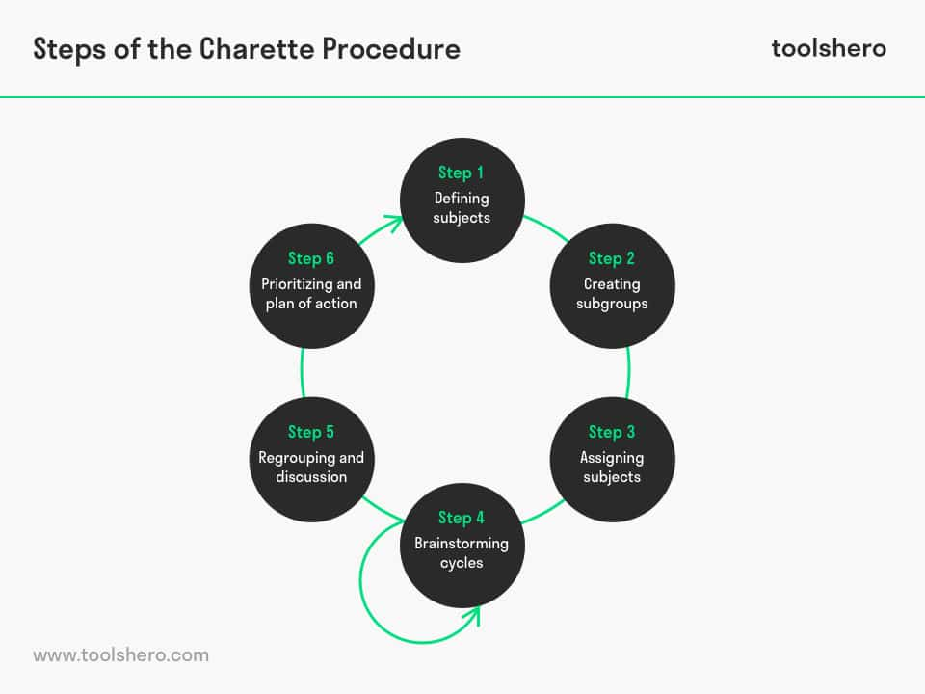

Slide 5
Step 1: defining subjects
The recorder comes to an agreement with the groups about the problems that will be discussed.
Step 2: creating subgroups
The recorder divides the group into smaller subgroups with a maximum number of seven people. It’s good to form diverse groups, so that different skill sets make a contribution and creativity is encouraged.
Step 3: assigning subjects
The recorder assigns a problem to each subgroup and possibly lets each subgroup choose its own recorder to collect and record ideas.

Slide 6
Step 4: brainstorming cycles
The discussions start and the recorder monitors how much time the groups have to discuss the topic. He then collects the ideas from the first group and hands them to the second, who will then start working on it. In that fashion, he assigns ideas per group and then passes them on to the next group.
Step 5: regrouping and discussion
When all topics have been discussed by all subgroups and sufficient ideas have been generated, the entire group comes together. Led by the recorder, they discuss the results for each topic. At this stage, the ideas are sorted and divided into good and not-so-good ideas.
Step 6: prioritizing and plan of action
Based on the ideas that have been offered, grades are assigned and priorities are set. That makes it easy to come up with a plan of action based on the filtered ideas. Democratic decision making can help to priorities the required actions.

Slide 7
When to Use the Charette Procedure?
In the project initiation stage or problem-solving meetings, a large number of attendees may result in losing control, unnecessary debates, and sometimes conflict that prevents reaching effective solutions. In these instances, brainstorming sessions may lead to problems instead of solving them. A loss of direction may also occur because many topics can be discussed at the same time. Therefore, the Charette Procedure should be applied in the following scenarios:
More than one topic being discussed during the session
When a large number of people (15-25) are involved in the discussion
The time to discuss each topic is limited
Building on existing ideas created by others
To ensure all the attendees contribute to the discussion

Slide 8
How the Charette Procedure Works
To ensure a successful Charette Procedure, thorough preparation should be considered to manage the ideas of each small group. The preparation of participants will include the following steps:
Divide the participants into small groups, around five groups in each session.
Ask each group to choose someone to record the ideas and document them, this person is called the recorder.
Ask each group to choose a topic. If the number of groups is larger than the topics, two groups may share the same topic to discuss separately.
Assign time for the groups to generate ideas, generally, it can be around 10 minutes for each group.

Slide 9
After preparing the groups for the discussion, small groups should start to brainstorm the topics and get their ideas circulated based on the following steps:
Step 1
Each group discusses the assigned topic and the recorder collects the ideas to document it through notes. The leader for all the groups may warn the attendees about the time to make sure they are focused and remain active in discussing all the ideas within the 10 minutes limit.
Step 2
The recorder takes the ideas from the first group and moves to the second group to facilitate discussion of the ideas created by the initial group. The recorder collects and document the new ideas that may be generated based on this second round.

Slide 10
Step 3
The recorder repeats the process with the third group. All groups are asked to review and discuss each the ideas related to all topics.
Step 4
At the end round of the discussion, each group is asked to prioritize the ideas based the most important and significant ideas in each topic.
Step 5
Each recorder collects all the ideas, and summarizes them based on each topic. This step merges the efforts of all the groups and helps to compare the collected ideas for a more complete understanding of the topics.

Slide 11
Step 6
The entire group meets and discusses the results related to each topic. At this stage, they review the priorities of each decision. The resulting decisions may be implemented in the form of an Action Plan for the next stages of the project.
Benefits of using the Charette procedure
Get participants from diverse backgrounds to foster a broader perspective
Stimulate creativity
Rapidly iterate and develop ideas
Gain stakeholder buy-in
Make decisions quickly
Improve design quality

Slide 12
Those are the upsides. But with a larger group comes some downsides, too:
It’s time and resource intensive
Some voices tend to dominate the conversation
It’s often challenging to facilitate
There’s a more significant potential for conflict
Ideas often come at the expense of execution
Greater risk of scope creep

Slide 13
Key Points
The Charette Procedure is an efficient and effective process for brainstorming and capturing ideas when there are multiple issues to discuss and many people involved.
It is a systemic and organized approach that allows everyone to contribute in a meaningful way.
When you are faced with a complex, multiplayer decision, the Charette Procedure is a great way of identifying the options available and laying the foundations of well-considered and widely accepted plans.

Slide 14
Question :
Which of the following is a primary advantage of the Charrette Procedure?
○ It ensures consensus through anonymity.
○ It allows for broad stakeholder involvement in decision-making.
○ It eliminates the need for structured facilitation.
○ It reduces the time needed for brainstorming.
Notes:
Ans: b

Slide 16
THANK YOU

